Slide 1

DJJJ Presents
PBET
Personal Budget & Expense Tracker
Dawson, Brown
Judah, Csanyi
Joshua, Leslie
Jeremy, Paruch

Slide 2
Meet
The
Team

Slide 3




Meet
The
Team
Primary: JS Programmer
Primary: JS Tester
Primary: JS Programmer
Primary: HTML & CSS Expert
Dawson Brown
Judah Csanyi
Joshua Leslie
Jeremy Paruch
Secondary: Bug Catcher/Trouble Shooter
Secondary: Bug Catcher/Trouble Shooter
Secondary: Bug Catcher/Trouble Shooter
Secondary: Organizer

Slide 4













Main Menu

Slide 5





Income Expense Logging
Income Expense Logging

Slide 6
1

Slide 7
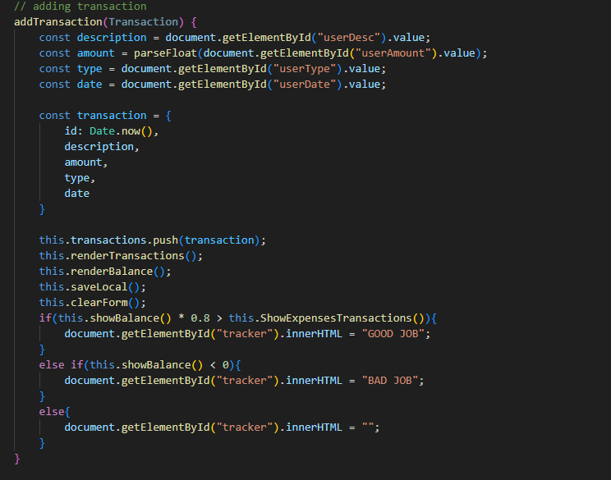
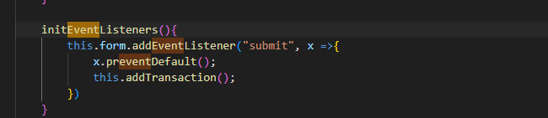
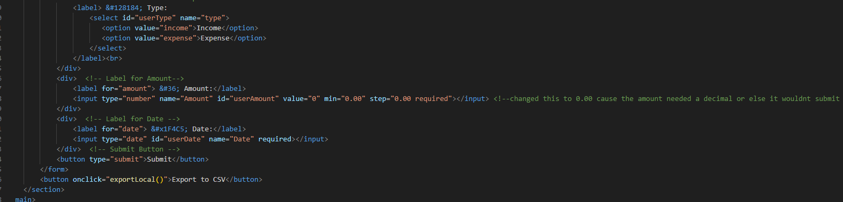
Input Income & Expenses
1

Slide 8
2

Slide 9
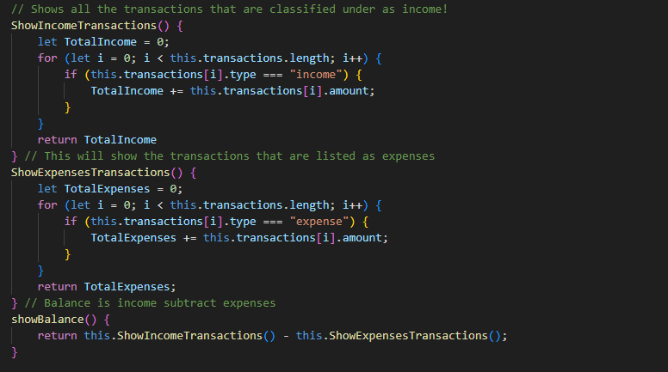
Calculate Total Income & Expenses
2

Slide 10
3

Slide 11
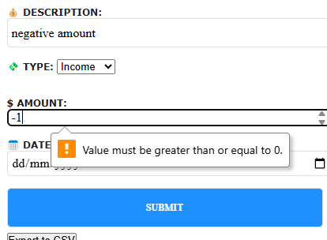
Preventing Negative Value
3

Slide 12

Basic Budgeting System
Basic Budgeting System

Slide 13
1

Slide 14
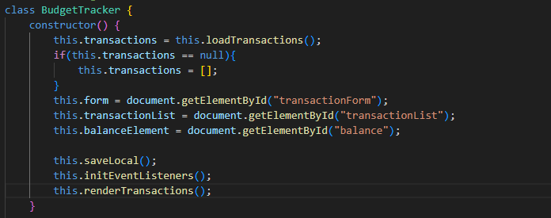
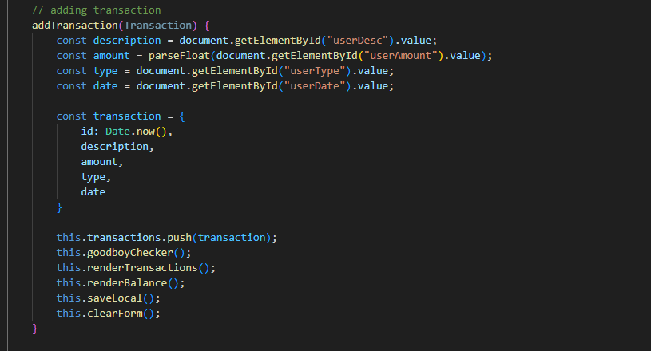
Budgeting System
1

Slide 15


Categorizing Expenses
Categorizing Expenses

Slide 16
1

Slide 17
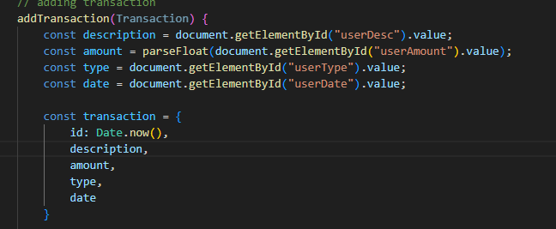
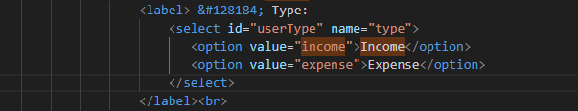
User Select Categories
1

Slide 18
2

Slide 19
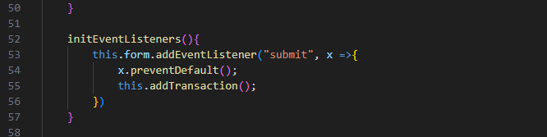
Multiple Transactions
2

Slide 20


Expense Tracking With Objects
Expense Tracking With Objects

Slide 21
1

Slide 22
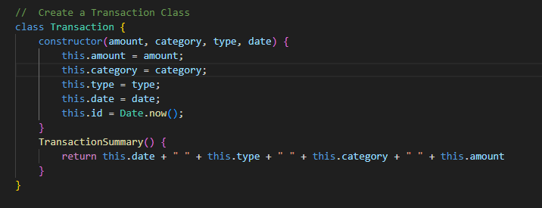
Tracking With Objects
1

Slide 23

View Transaction History
View Transaction History

Slide 24
1

Slide 25
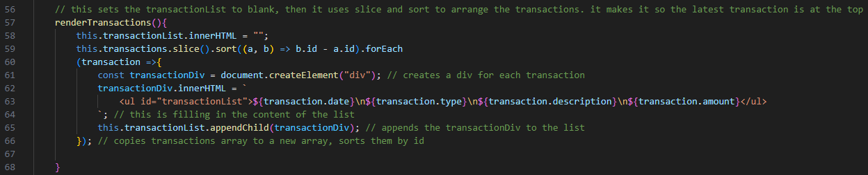
List of All Transactions
1

Slide 26

Local Storage
Local Storage

Slide 27
1

Slide 28
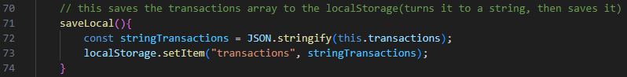
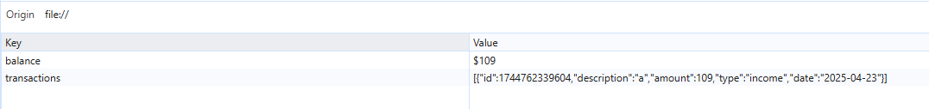
Save income, Expenses and Balance in Local Storage
1

Slide 29

CSV Export
CSV Export

Slide 30
1

Slide 31
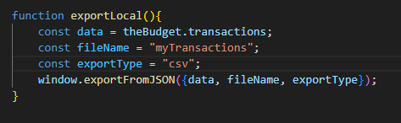
Save income, Expenses and Balance in Local Storage
1

Slide 32

LIVE DEMO
Live Demo!

Slide 33

Going Forward
Going Forward

Slide 34

Closing Remarks
Thank you!

Slide 35

Questions

